Slide 1
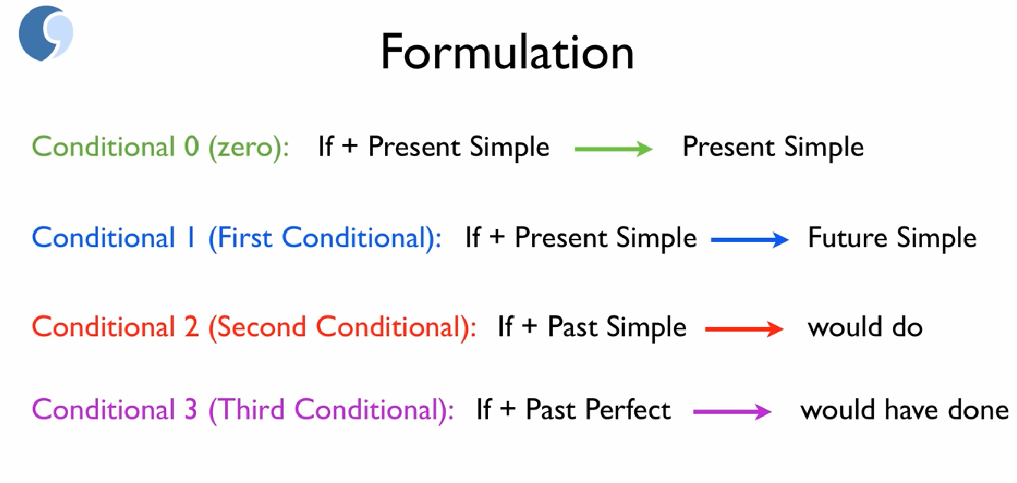

Slide 2
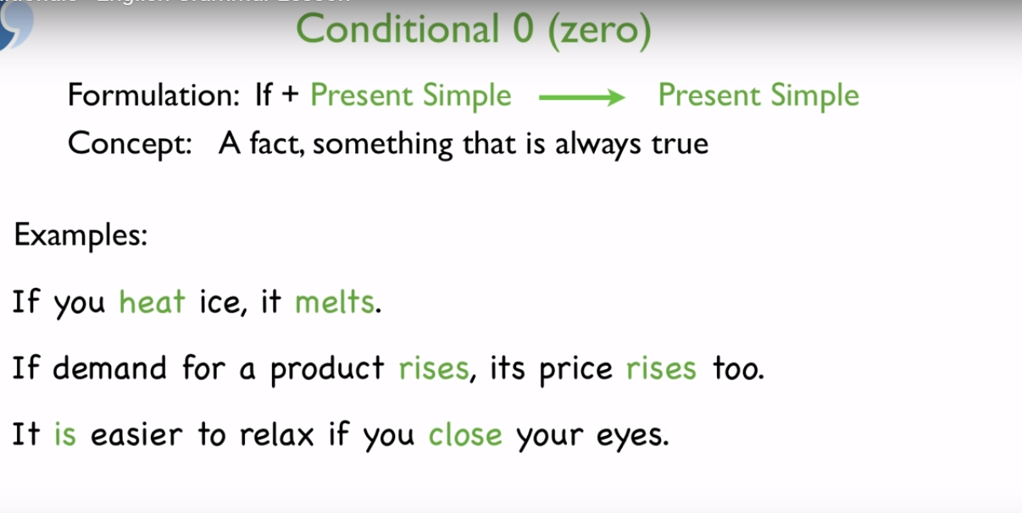

Slide 3
If this thing happens | that thing happens.

Slide 4
EXAMPLES
If you heat ice, it melts.
Ice melts if you heat it.
When you heat ice, it melts.
Ice melts when you heat it.
If it rains, the grass gets wet.
The grass gets wet if it rains.
When it rains, the grass gets wet.
The grass gets wet when it rains.

Slide 5
EXAMPLES
  If you freeze water, it becomes a solid.
  Plants die if they don't get enough water.
  If my husband has a cold, I usually catch it.
  If public transport is efficient, people stop using their cars.
  If you mix red and blue, you get purple.

Slide 6
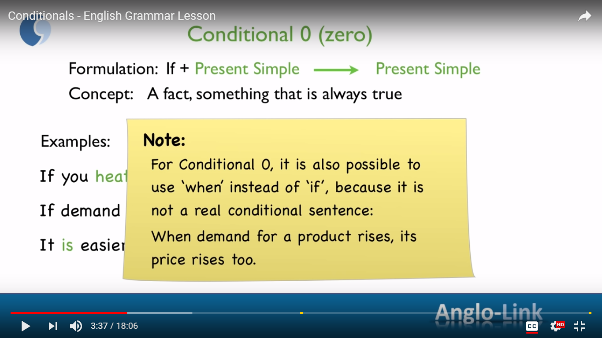

Slide 7
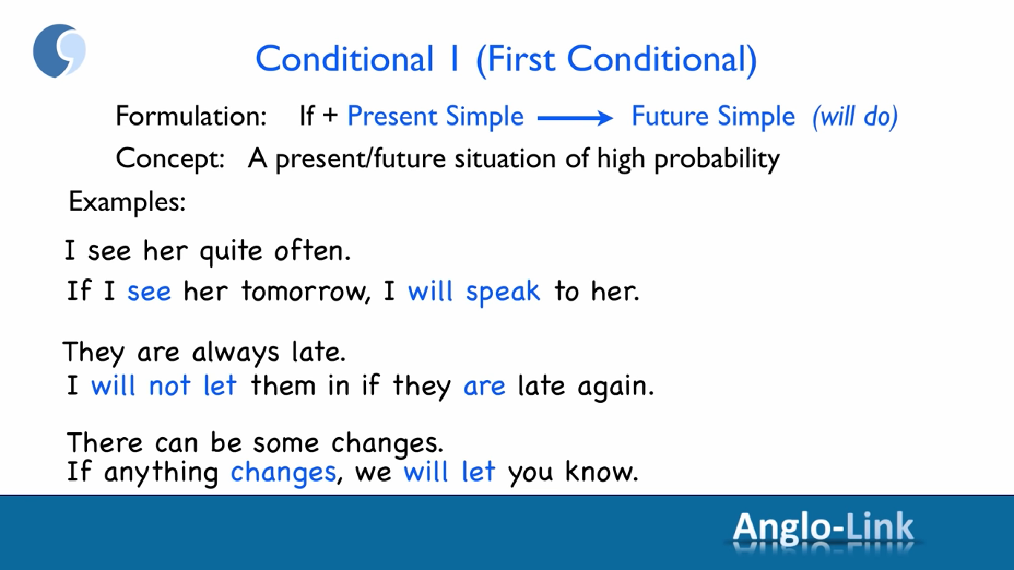

Slide 8
If clause | Main clause
If + simple present | simple future
If this thing happens | that thing will happen.
If you don't hurry | you will miss the train.
If it rains today | you will get wet.

Slide 9
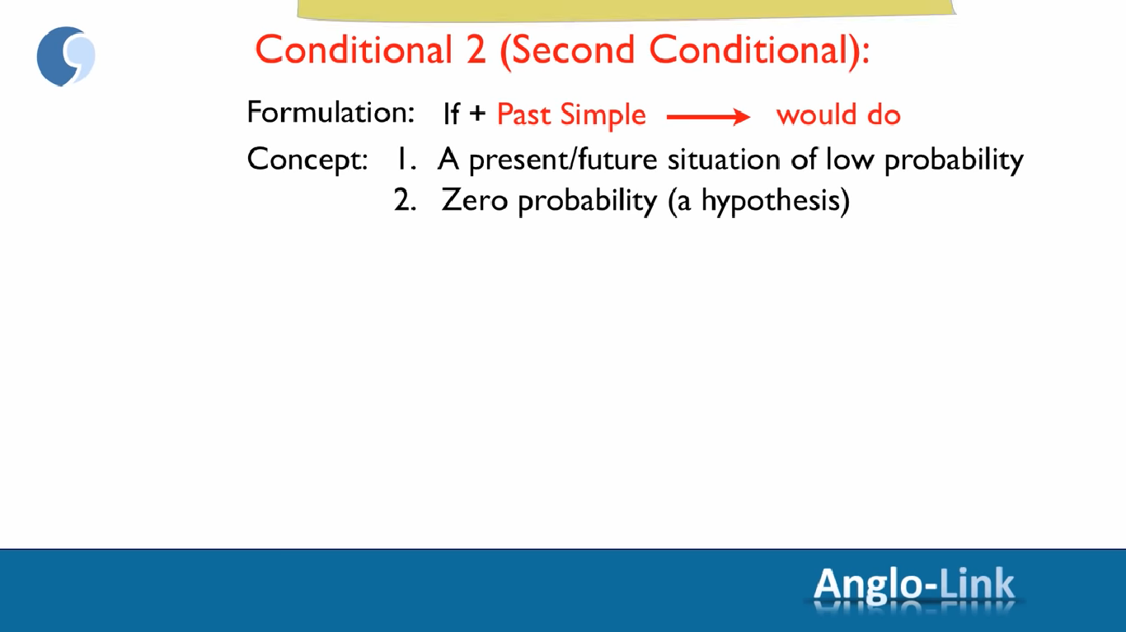

Slide 10
If you went to bed earlier | you would not be so tired.
If it rained | you would get wet.
If I spoke Italian | I would be working in Italy.

Slide 11
EXAMPLES
  If it rained, you would get wet.
  You would get wet if it rained.
  If you went to bed earlier you wouldn't be so tired.
  You wouldn't be so tired if you went to bed earlier.
  If she fell, she would hurt herself.
  She would hurt herself if she fell.

Slide 12
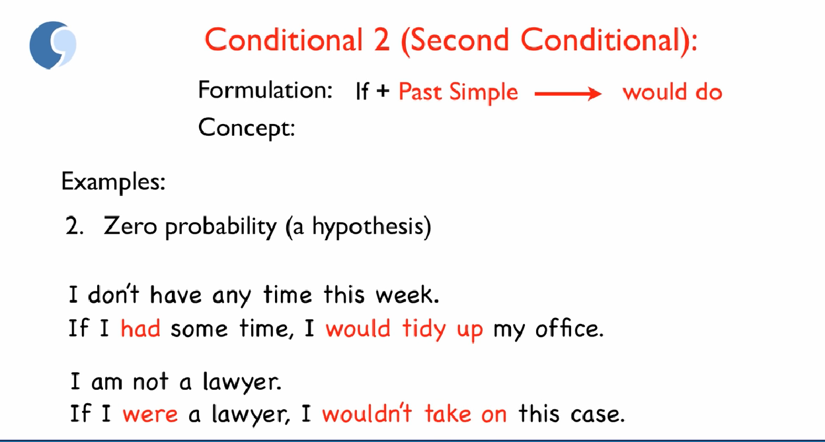

Slide 13
EXAMPLES
  If the weather wasn't so bad, we would go to the park. (But the weather is bad so we can't go.)
  If you really loved me, you would buy me a diamond ring.
  If I knew where she lived, I would go and see her.

Slide 14
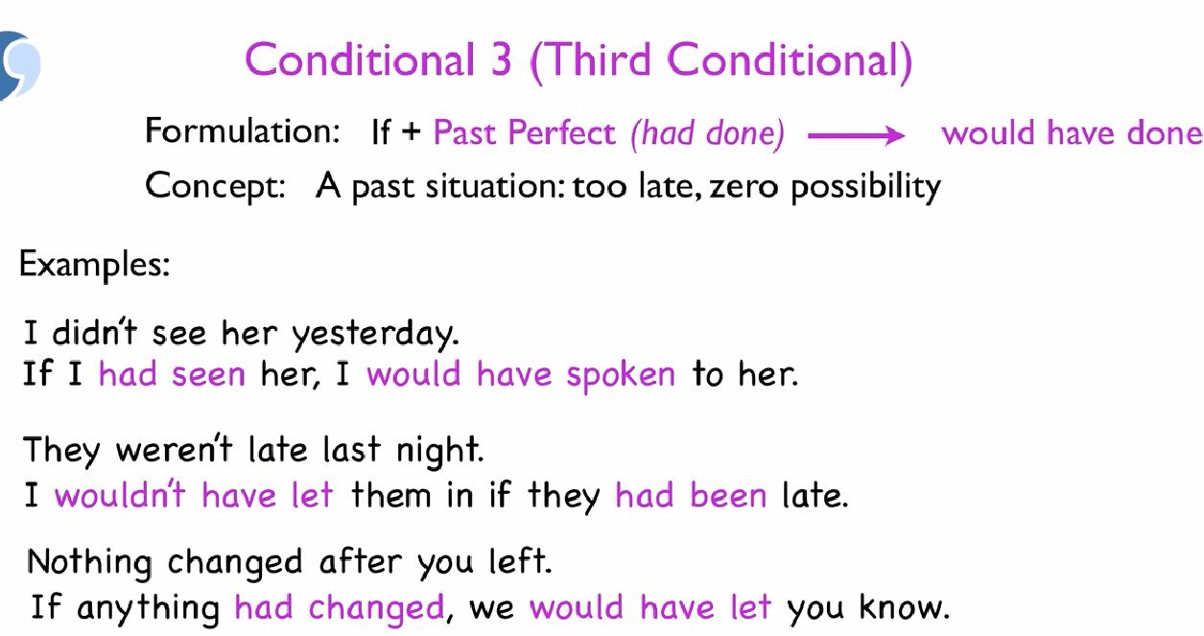

Slide 15
If you had studied harder | you would have passed the exam.
If it had rained | you would have gotten wet.
If I had accepted that promotion | I would have been working in Milan.

Slide 16
SUMMARY
If this thing happens that thing happens.
If this thing happens that thing will happen.
If this thing happened that thing would happen.
If this thing had happened that thing would have happened.

Slide 17
WEEKEND PLANS
Christine and Margaret are friends. They are both busy because the work and study! But on Wednesday they meet for coffee.
"What are you going to do this weekend?" asks Margaret.
"Well, I have a big project to finish for my design class. But if I can finish it by Friday, I'll do something fun as a treat," says Christine.
"That sounds great!" replies Margaret. "I think the ballet is coming to town. If it isn't too expensive, I'm going to buy tickets. Would you like to come?"
"Well, I don't really like ballet very much. If you want to go to the ballet in the evening, let's do something in the morning," says Christine.
"All right. If you have the energy, let's go swimming!" suggests Margaret.
"That sounds great! If I don't call you on Friday, send me an email at work," agrees Christine. "And if I don't answer, call me again. And if I don't pick up… oh, let's just make plans now! I'm too busy to plan later!"

Slide 18
If you were not born in the country you were in, what would your life be?

